Slide 1
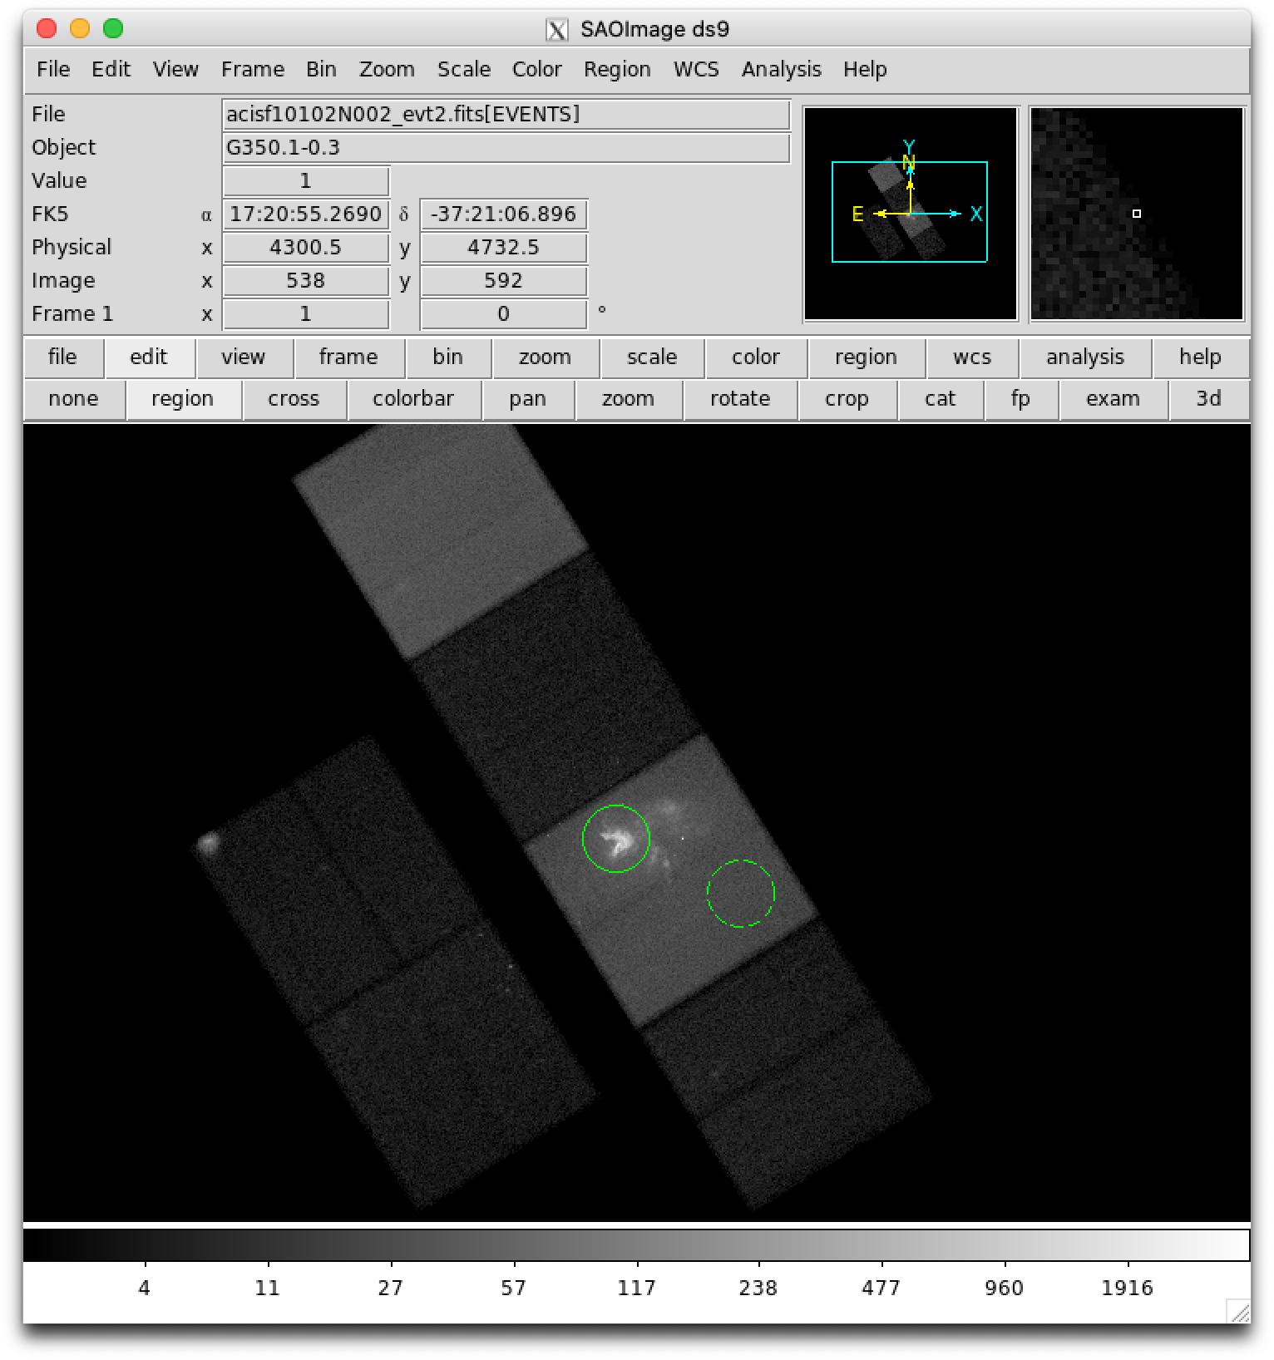
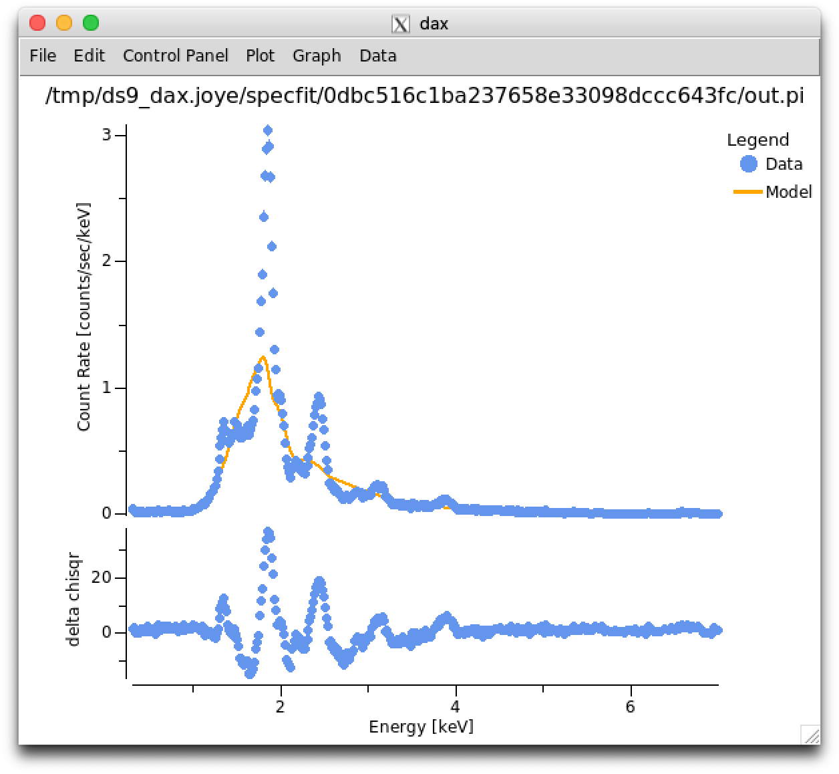
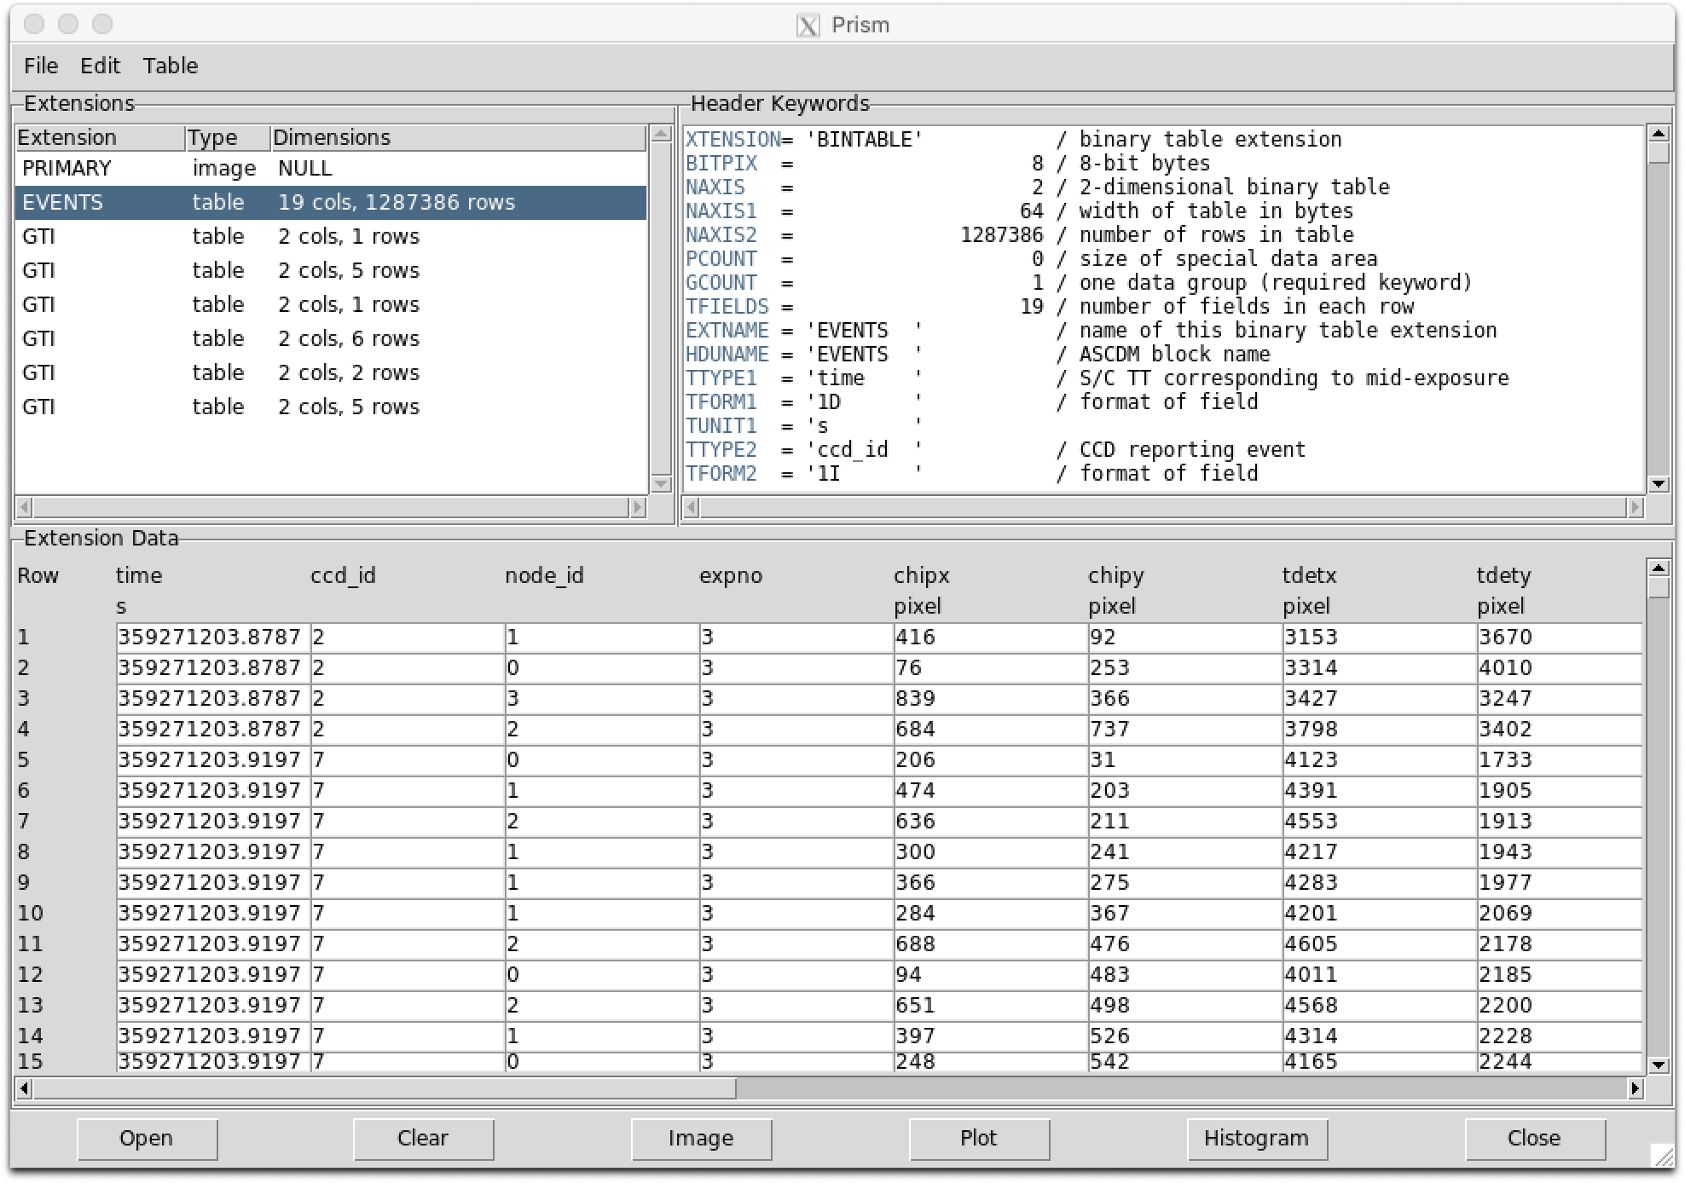

Slide 2
Where to find SAOImageDS9 v8.2
https://ds9.si.edu
Where to find the data, Lessons, Slides
https://ds9.si.edu/china-vo

Slide 3
What is SAOImageDS9?
SAOImageDS9 is NOT PhotoShop (or Gimp)
SAOImageDS9 allows the user to MAP from a pixel single numeric value to a pixel RGB triplet
Pixel (Floating point) > SAOImageDS9 > Pixel (RGB)
The output of SAOImageDS9 is an RGB image
which is the input for Photoshop or GIMP

Slide 4
What is SAOImageDS9?
SAOImageDS9 allows the user to MAP from a single numeric value to a RGB triplet depending upon:
Scale Distribution (linear, log, histogram)
Region of Distribution (low and high clip values)
Color Scale (grey, rainbow, heat, cool)
Contrast and Bias (redistribution of colors)

Slide 5
5 Lessons
1. Some Basic Features
2. Working with Catalogs
3. Creating RGB images
4. Working with IFU Data
5. Creating 3D Gif Movie

Slide 6
Lesson 1: Some Basic Features
Dark Mode and Themes
Exploring FITS files with PRISM
Using Command Line Options
Using XPA
Backup and Restore

Slide 7
Lesson 2: Working with Catalogs
Color-Magnitude Diagram with SIMBAD
Load FITS Image
Zoom to fit
Load SIMBAD Catalog
Create Plot
Adjust Plot Ranges

Slide 8
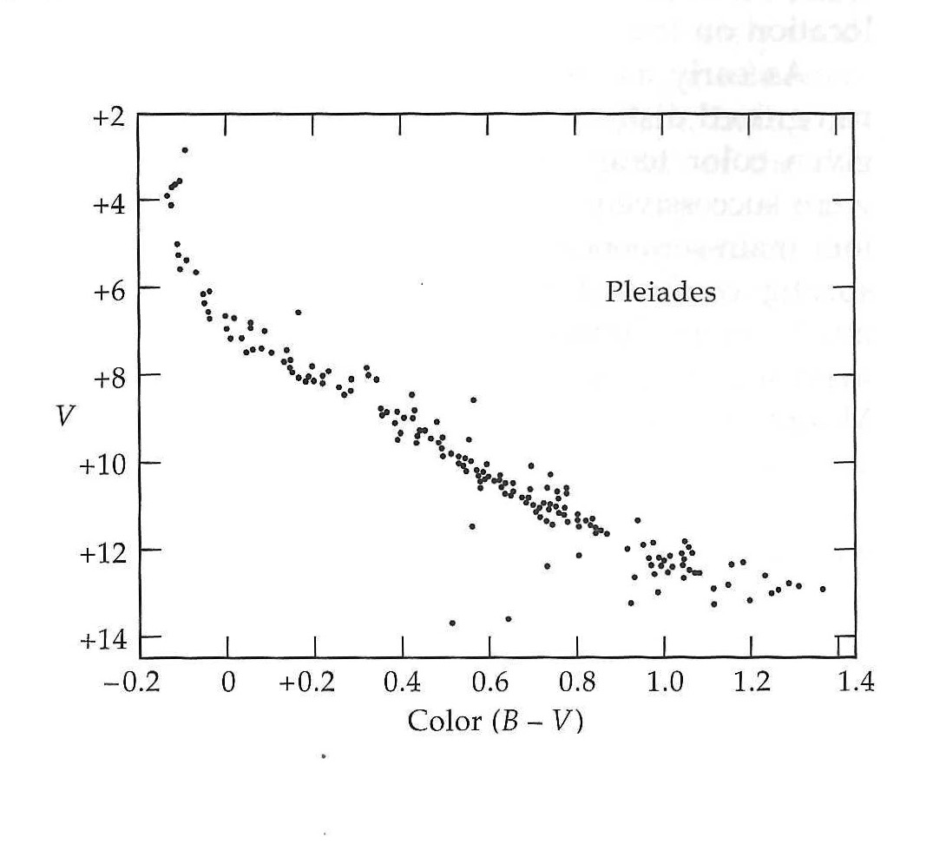
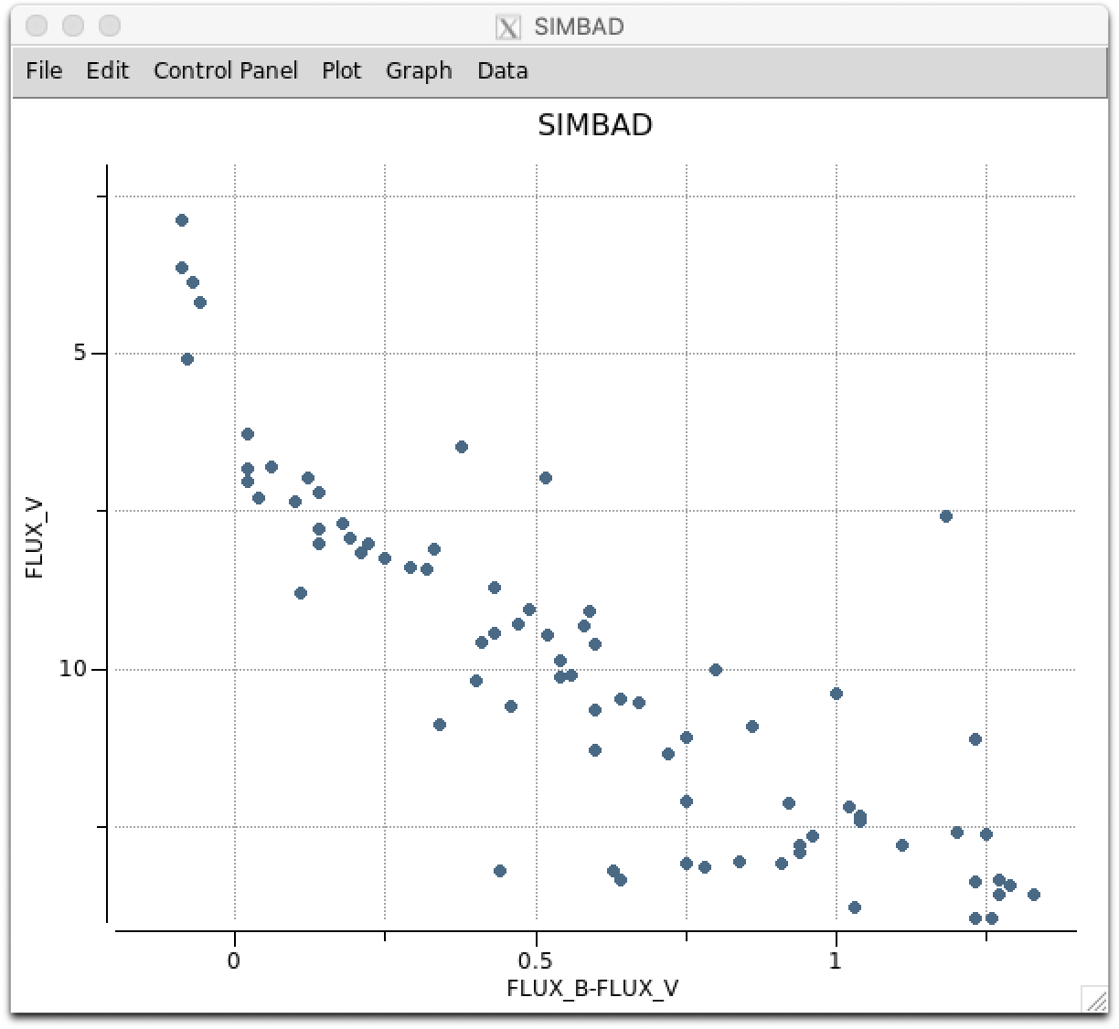
Lesson 2: Working with Catalogs
Color-Magnitude Diagram with SIMBAD
H.L. Johnson and R.I. Mitchell

Slide 9
Lesson 3: Creating RGB Images
Create RGB Frame
Select Red Channel
Load FITS image into Red Channel
Adjust Scale
Select Green Channel
Load FITS image into Green Channel
Adjust Scale
Select Green Channel
Load FITS image into Green Channel
Rotate and Zoom

Slide 10
Lesson 4: Working with IFU Data
Finding Ha in SDSS Data Cube
Load FITS Data Cube
Zoom to 4
Set scale to ZSCALE
Set scale to GLOBAL
Create CIRCLE region at center
Get CIRCLE region dialog
Create PLOT3D
Find Ha Peak

Slide 11
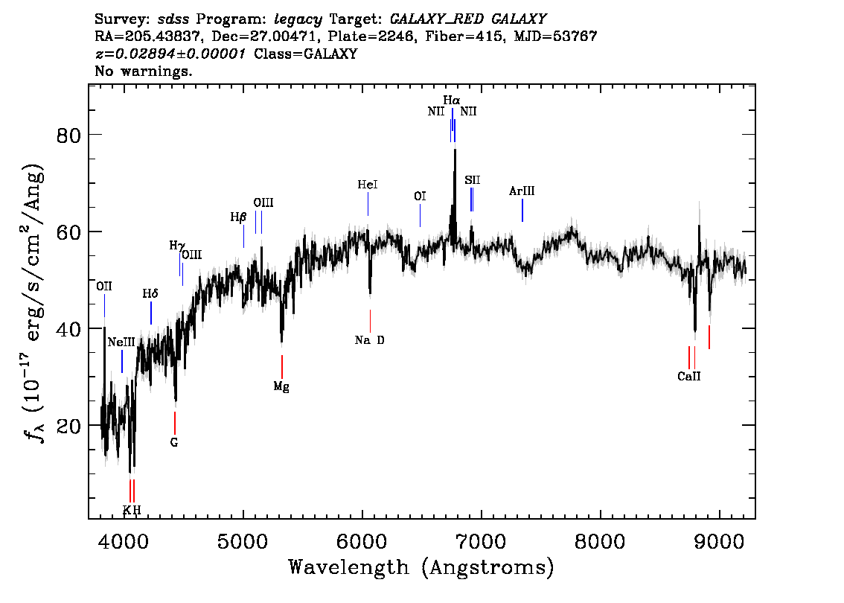
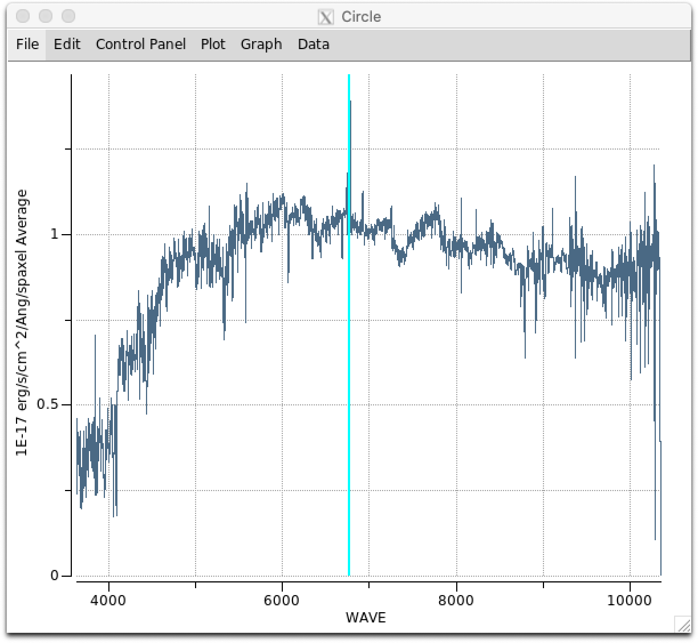
Lesson 4: Working with IFU Data
Finding Ha in SDSS Data Cube
http://skyserver.sdss.org/dr13/en/tools/explore/summary.aspx?ra=205.4384&dec=27.004754

Slide 12
Lesson 5: Creating 3D Gif Movie
Using SDSS Data Cube
Create 3D frame
Load FITS Data Cube
Set view point angles
Crop the data cube in Z for region of interest
Set scale to ZSCALE
Set colormap to HEAT
Set Zoom and recenter
Create movie

